Slide 1



LAB 1:
PYTHON FOUNDATION
University of Washington, Seattle
Spring 2022

Slide 2
OUTLINE
Part 1: Getting Started (video link)
Python Environment Setup
Part 2: Python Basics (video link)
Data types & variables
Operators in Python
Conditionals, Loops, Functions
Part 3: NumPy and Plotting (video link)
Introduction to NumPy
Plotting with Matplotlib
Supplementary: Basic Debugging in Python (video link)
Tips for minimizing errors
Debugging with ‘print’
Debugging with PDB
Using Google / Stack Overflow

Slide 3
PART 1: GETTING STARTED Python Environment Setup

Slide 4
Python Environment Setup

Slide 5


Python Environment Options
Anaconda 3
Google Colaboratory
Offline
Online

Slide 6
What is Anaconda 3?
Distribution of Python and R for scientific computing
Comes with >250 packages automatically installed
>7500 additional open-source packages available in conda website
Equipped with Jupyter Notebook
Conda environment manager for easy maintenance of packages

Slide 7
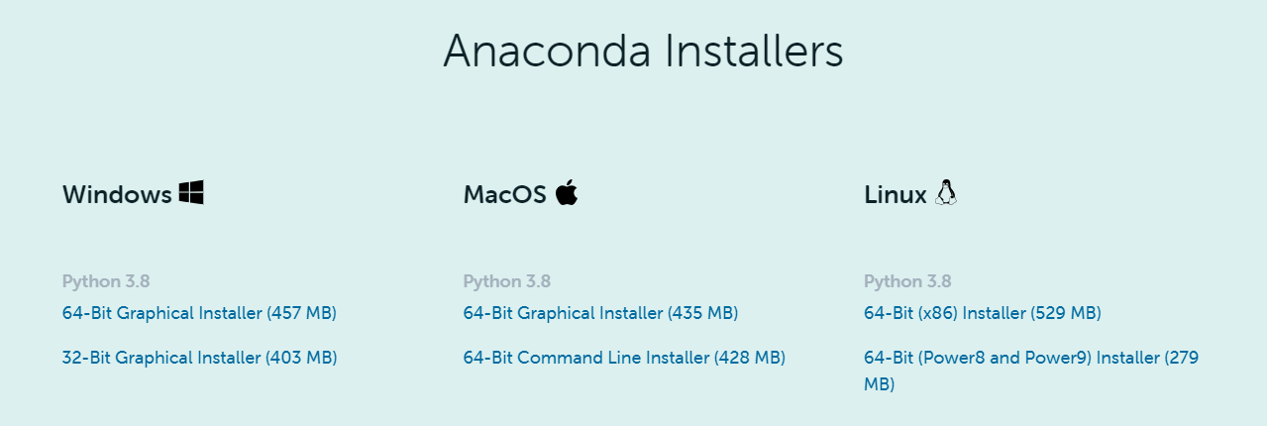
Setting up Anaconda 3
Installing Anaconda 3
https://www.anaconda.com/products/individual
Notes:
Installing Anaconda on your computer is very easy.
All you have to do is to go to this website and download the Anaconda installer that is compatible with your Operating System.
Once you download the installer, execute the installer and simply follow the instruction

Slide 8
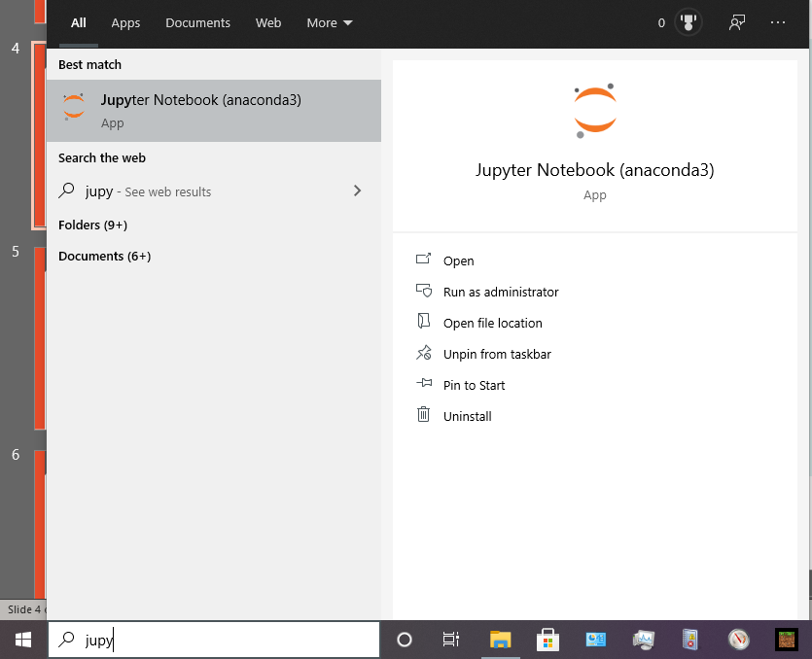
Setting up Anaconda 3
Windows
Mac/Linux
Start terminal
Type “jupyter notebook”
Added to start menu after installing Anaconda 3

Slide 9
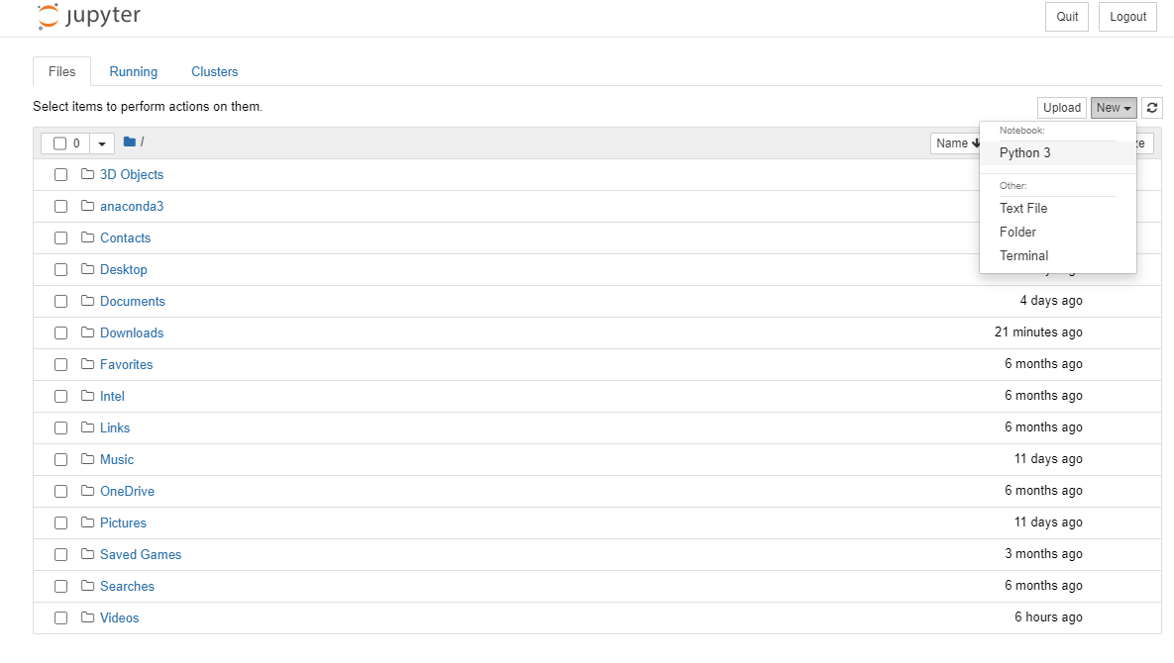
Setting up Anaconda 3
Create a new notebook
You can also use Jupyter Navigator to load .ipynb notebook files

Slide 10
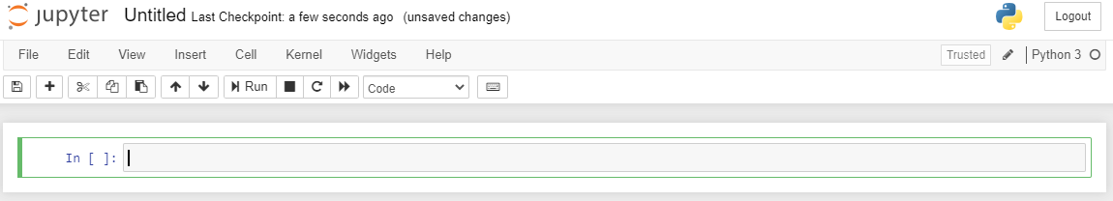
Jupyter Notebook
Notebook Title
Python
version
Cell
control bar
Tool bar
Cell type (code, markdown, raw)
Jupyter Cell
See https://www.dataquest.io/blog/jupyter-notebook-tutorial to familiarize yourself with basic controls

Slide 11
Google Colaboratory
A free Jupyter notebook environment that runs in the cloud
Saves in Google drive
Github commit style code sharing with others
Maximum runtime of 12hrs (Free version)
Pre-equipped with latest scientific packages (Numpy, Scipy, etc)

Slide 12
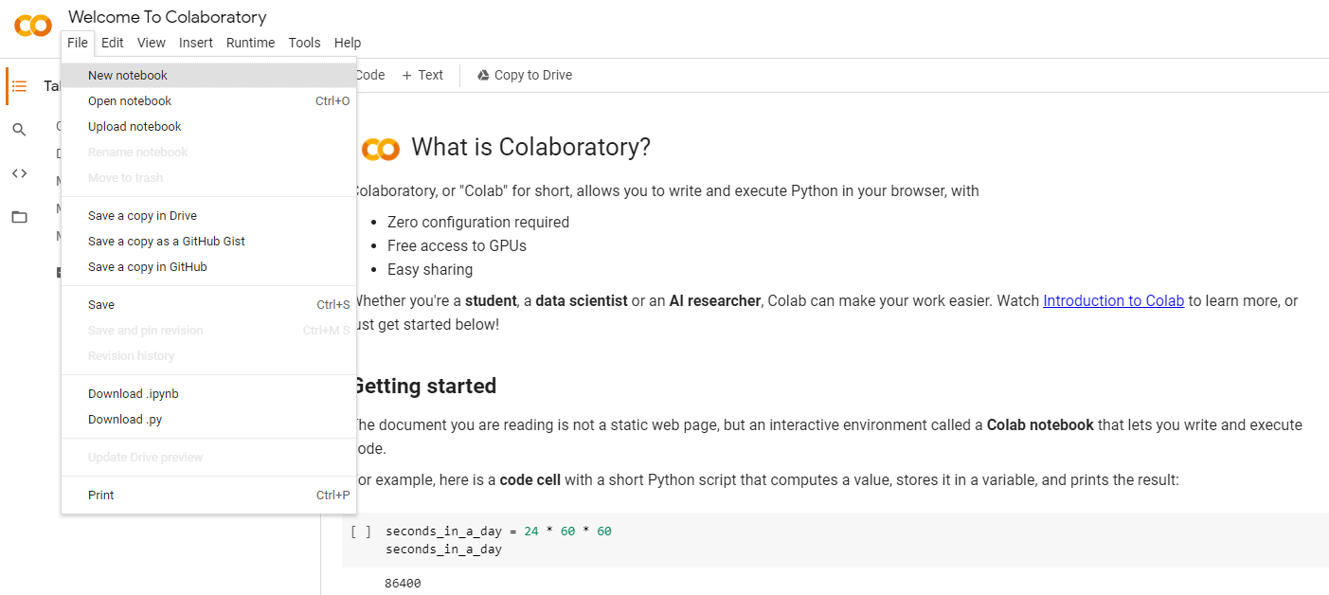
Setting up Google Colaboratory
Tutorial to Colab
https://colab.research.google.com/notebooks/intro.ipynb
Create new Notebook

Slide 13
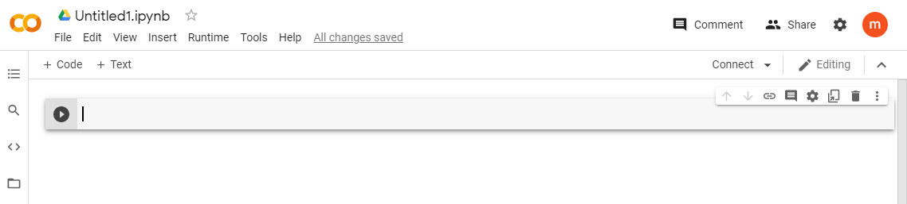
Setting up Google Colaboratory
Notebook Title
Share settings
Tool bar
Cell control bar
Jupyter Cell (code, markdown text)
See Getting Started part of https://colab.research.google.com/notebooks/intro.ipynb to familiarize yourself with basic controls

Slide 14
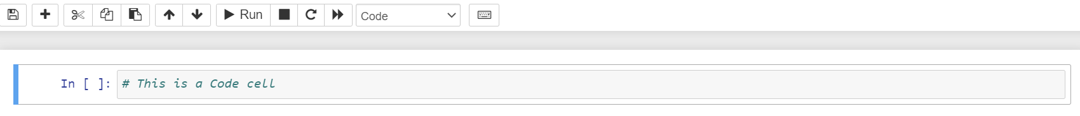
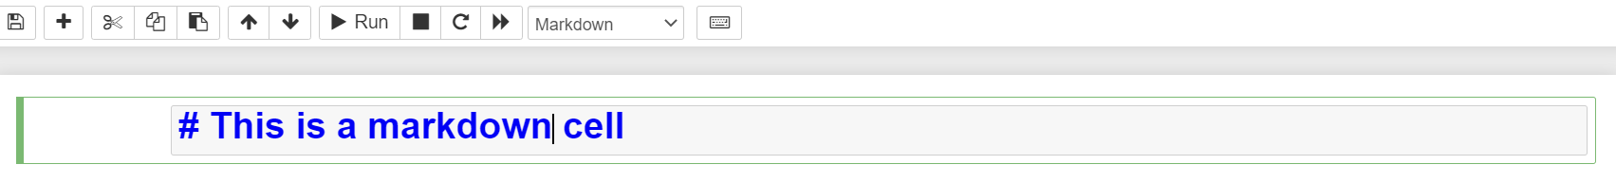
Code vs Markdown Cell
Jupyter Notebook
Add a new cell
Google Colab

Slide 15
PART 2: PYTHON BASICS Python Data Types and Variables Operators in Python Conditionals, Loops, Functions

Slide 16
Python Data Types and Variables

Slide 17
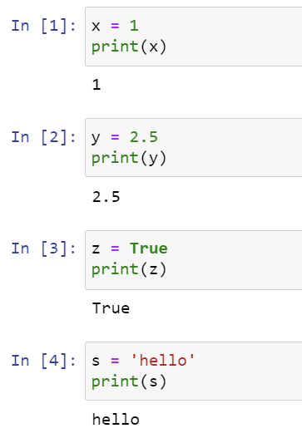
Python Data Types and Variables
Jupyter Notebook Code
Variable
Data Type
Value
x
int
1
y
float
2.5
z
bool
True
s
str
‘hello’

Slide 18
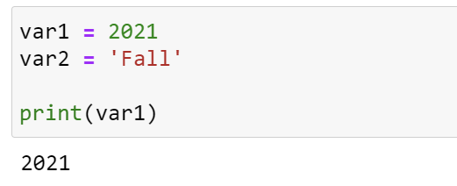
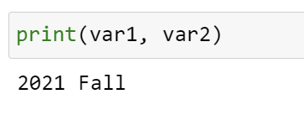
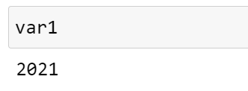
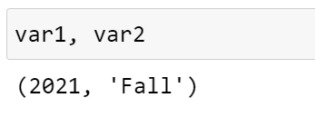
Printing Variables with ‘print’
Print single variable
Print multiple variable
Variables called in a cell can be displayed without print function, as ‘outputs’

Slide 19
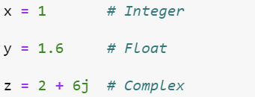
Python Data Types: Numbers
Python Numbers
Integers
Floats
Complex
Examples
1, 300, -50
0.001, -15.7, 6.5, 1.0
6.4 – 3.6j, 8j, -10-2j

Slide 20
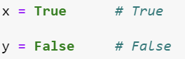
Python Data Types: Booleans
Boolean
True
False
First letter should be capitalized

Slide 21
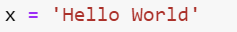
Python Data Type: Strings
H
e
l
l
o
W
o
r
l
d
Index
0
1
2
3
4
5
6
7
8
9
10
Length of string = 11

Slide 22
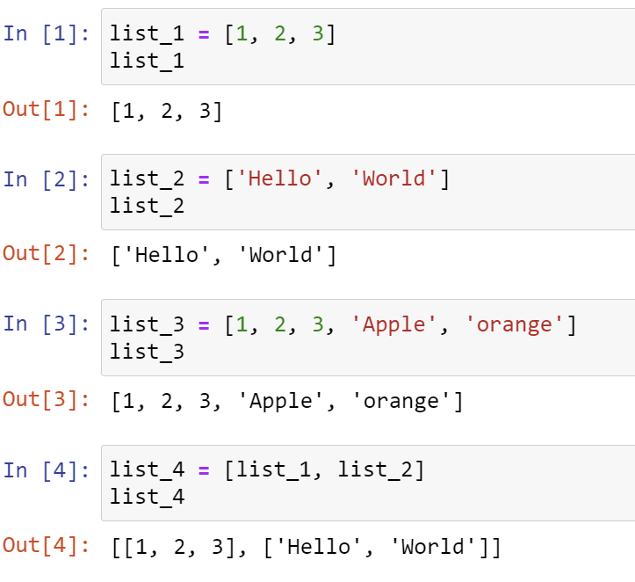
Grouping Data with Python Lists
List of numbers
List of strings
List of numbers + strings
List of lists

Slide 23
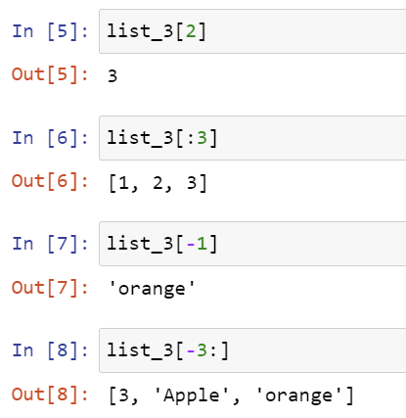
Indexing Lists
1
2
3
‘Apple’
‘orange’
Index
0
1
2
3
4
More information on indexing:
https://railsware.com/blog/python-for-machine-learning-indexing-and-slicing-for-lists-tuples-strings-and-other-sequential-types/

Slide 24
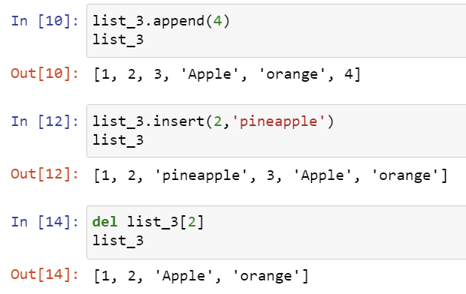
Append, Insert, Delete List Elements
Appending a new value
Inserting a new value into an index
2: Index to insert,
‘pineapple’: Value to insert
Deleting an existing value
2: Index to delete

Slide 25
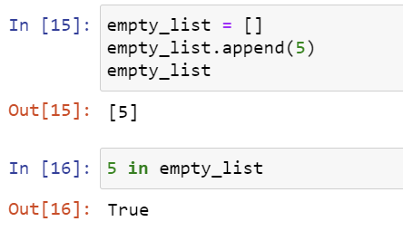
Empty List and Element Check
Appending a value to an empty list []
Checking if an element is in the list

Slide 26
Operators in Python

Slide 27
Operators in Python
1. Binary Operator
Operand
Operator
Operand
OUTPUT
2. Unary Operator
Operator
Operand
OUTPUT
Notes:
Binary vs unary operators

Slide 28
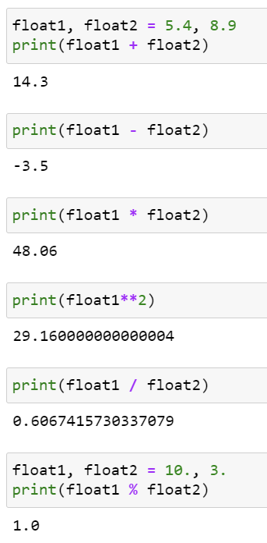
Arithmetic Operators
Operator
Example
Addition
Subtraction
Multiplication
Exponent
Division
Modulo
+
-
*
**
/
%

Slide 29
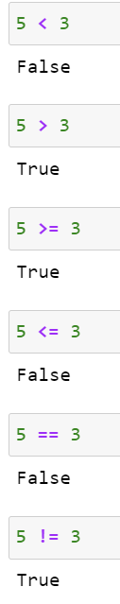
Comparison Operators
Operator
Example
Greater Than
Less Than
Greater Than or Equal to
Less Than or Equal to
Equivalent to
Not Equivalent to
<
>
>=
<=
==
!=

Slide 30
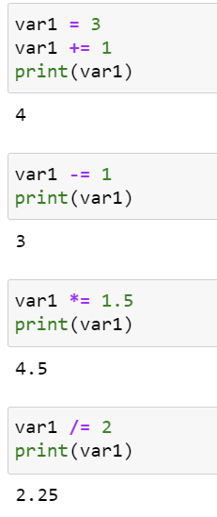
Assignment Operators
Operator
Example
Add and Assign
Subtract and Assign
Multiply and Assign
Divide and Assign
+=
-=
*=
/=

Slide 31
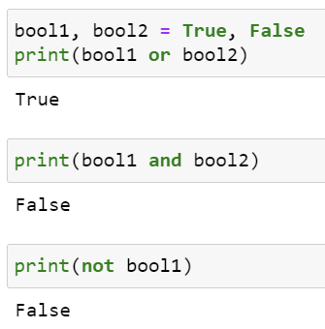
Logical Operators
Operator
Example
OR
AND
NOT
or
and
not

Slide 32
Conditionals, Loops, Functions

Slide 33
Conditional Statements
Conditional Statement
Types of conditional statements in Python
If
If-else
If-elif-else
True?
Path 1
Path 2

Slide 34
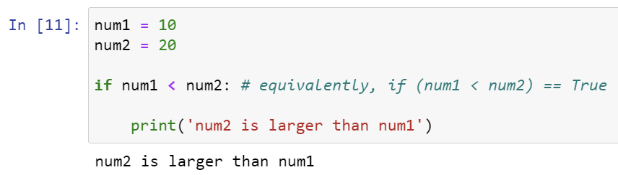
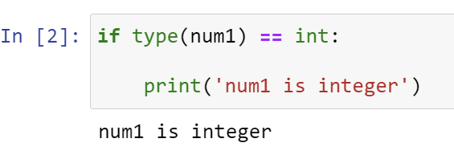
if statement
Implementation structure
Code example
If condition:
Code to be executed

Slide 35
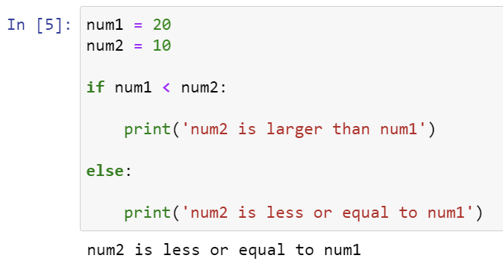
If-else Statement
Implementation structure
Code example
If condition:
Execute this code
else:
Execute this code instead

Slide 36
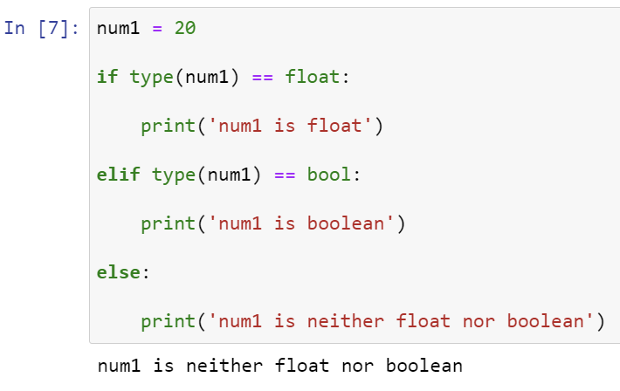
If-elif-else Statement
Implementation structure
Code example
If condition 1:
Execute this code
elif condition 2:
Execute this code instead
else:
Execute this code instead
Note: You can have multiple elif conditions between if and else

Slide 37
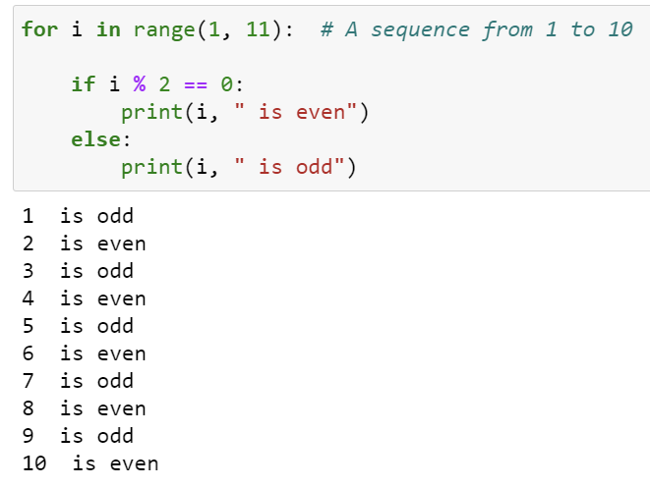
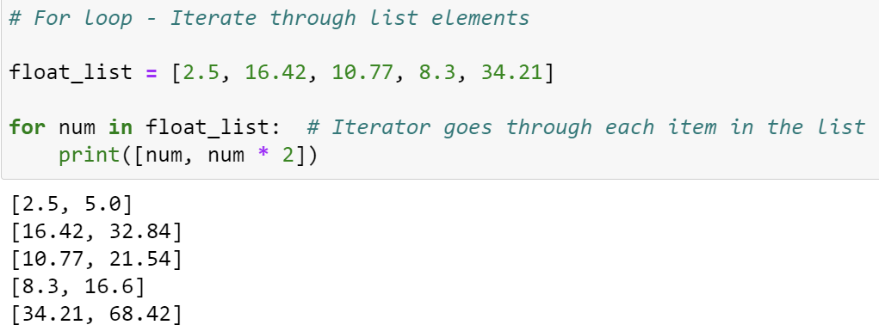
for Loop
Iterate through sequence
for iterator in sequence
Set of operations
Iterate through list elements

Slide 38
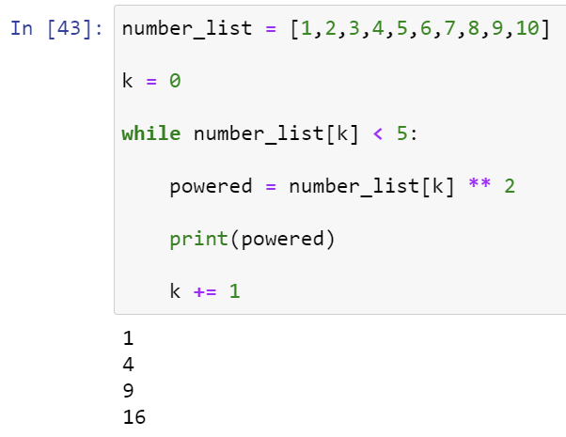
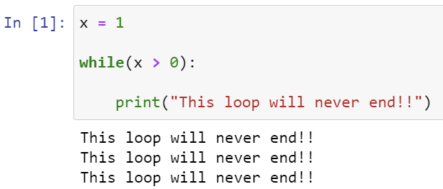
while Loop
while condition is true
Set of operations
Note: while loop has a potential to run infinitely
if not set correctly

Slide 39





Functions
Function
Set of Instructions
INPUTS
OUTPUT

Slide 40
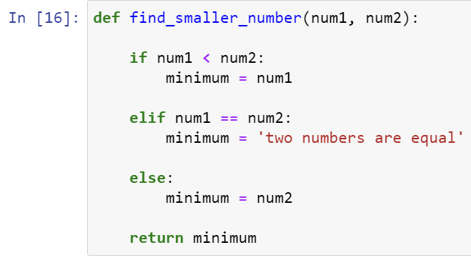
Defining Functions
Define function name
Input parameters
Set of instructions
Note: ‘return’ is NOT required for defining a function
Return output

Slide 41
PART 3: NUMPY AND PLOTTING Introduction to NumPy Plotting with Matplotlib

Slide 42
Introduction to NumPy

Slide 43

What is NumPy?
Fundamental package for scientific computing in Python
Supports multi-dimensional array object
Provides assortment of mathematical routines for arrays
Fast array operations through pre-compiled C
Support array-wide broadcasting for operations
Included in Anaconda 3

Slide 44
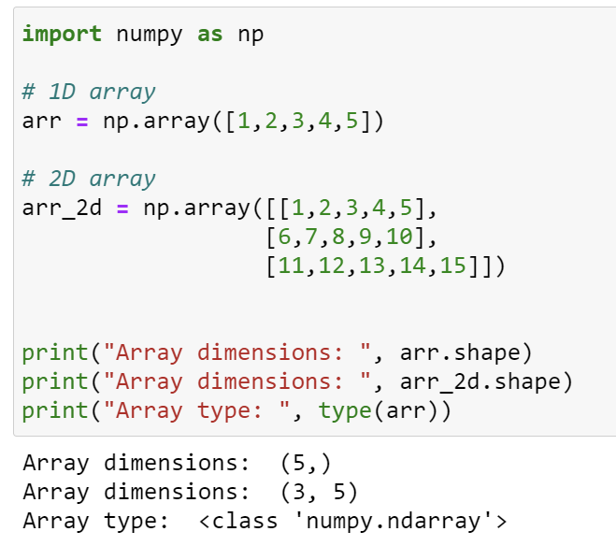
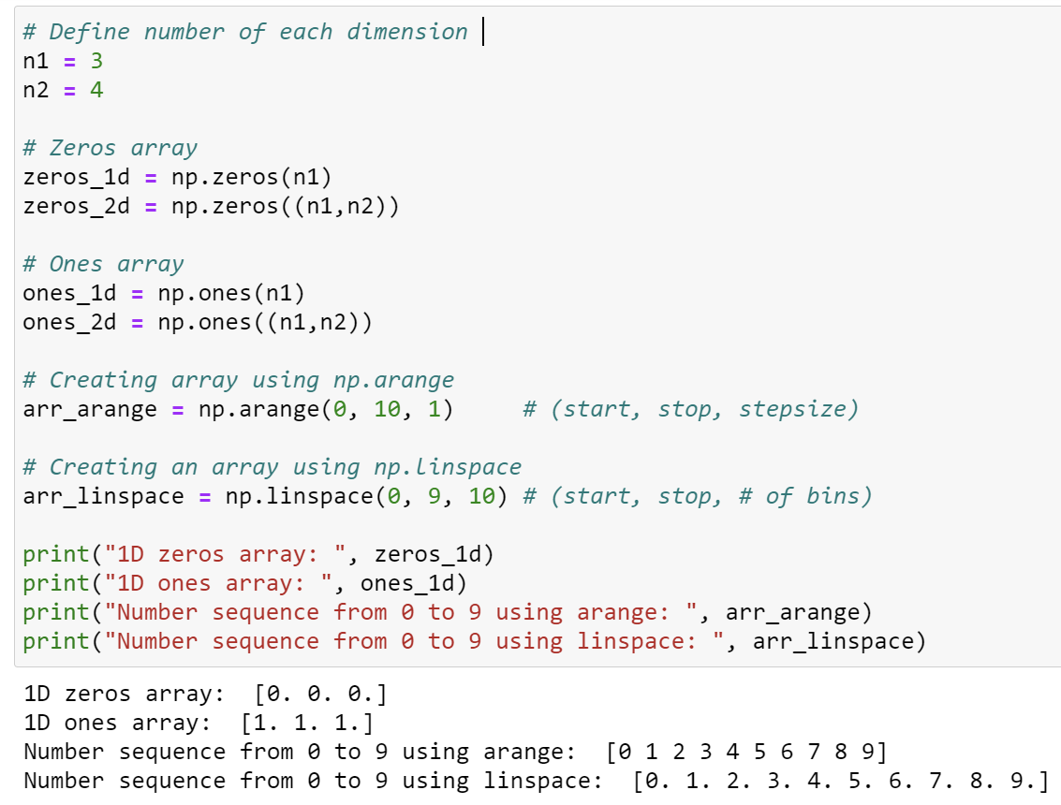
Constructing NumPy Arrays
From Python lists
From Numpy commands

Slide 45
Data Structures as Numpy Arrays
Axis 0
Axis 0
Axis 0
Axis 1
Axis 2
Axis 1
1-D
2-D
3-D
Shape = (i,)
Shape = (i,j)
Shape = (i,j,k)
e.g. time series data
e.g. data frame, table, greyscale image
e.g. RGB color image
Notes:
Stock data

Slide 46
Slicing Arrays (1D)
Axis 0
arr
arr[2:]
arr[-3:]
arr[:3]
arr[:-2]
arr[1:4]
arr[-4:-1]
arr[4]
arr[-1]
=
=
=
=

Slide 47
Slicing Arrays (2D)
Axis 0
Axis 1
arr
arr[:3]
arr[:3, :]
arr[:-2]
arr[:-2, :]
arr[2:]
arr[2:, :]
arr[-3:]
arr[-3:, :]
arr[:, 1:4]
arr[:, -4:-1]
arr[4]
arr[4, :]
arr[-1]
arr[-1, :]
=
=
=
=
=
=
=
=
=
=

Slide 48
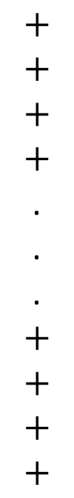
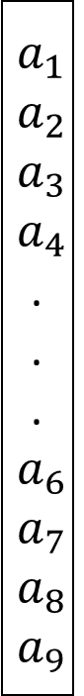
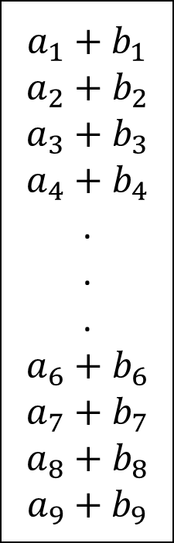
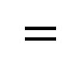
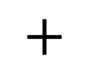
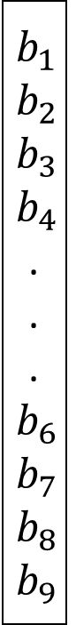
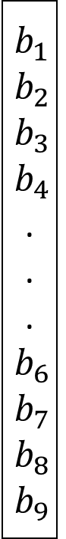
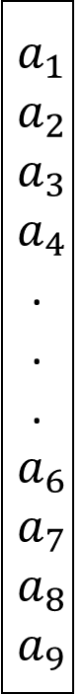
Array-wide Operations in NumPy
arr1
arr2
arr3
$$a_{1}$$
$a_{2}$ $a_{3}$ $a_{4}$
.
.
. $a_{6}$ $a_{7}$ $a_{8}$ $a_{9}$
$$b_{1}$$
$b_{2}$ $b_{3}$ $b_{4}$
.
.
. $b_{6}$ $b_{7}$ $b_{8}$ $b_{9}$
$$a_{1}$$
$a_{2}$ $a_{3}$ $a_{4}$
.
.
. $a_{6}$ $a_{7}$ $a_{8}$ $a_{9}$
$$+$$
$$+$$
$$+$$
$$+$$
.
.
.
$$+$$
$$+$$
$$+$$
$$+$$
$$b_{1}$$
$b_{2}$ $b_{3}$ $b_{4}$
.
.
. $b_{6}$ $b_{7}$ $b_{8}$ $b_{9}$
$${a_{1}+b}_{1}$$
${a_{2}+b}_{2}$ ${a_{3}+b}_{3}$ ${a_{4}+b}_{4}$
.
.
.
${a_{6}+b}_{6}$ ${a_{7}+b}_{7}$ ${a_{8}+b}_{8}$ ${a_{9}+b}_{9}$
$$+$$
$$=$$
numpy.add(arr1, arr2)
Notes:
Array broadcasting in lab 2?

Slide 49
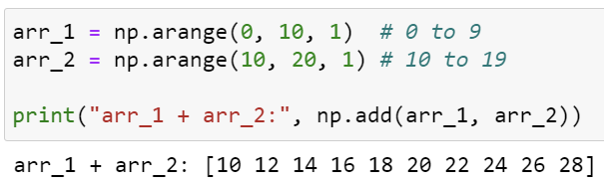
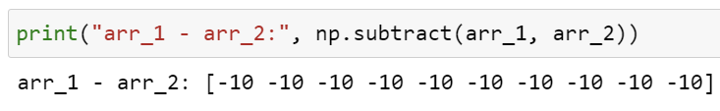
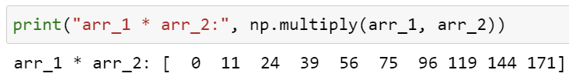
NumPy Arithmetic Operators
Operator
Example
Addition
Subtraction
Multiplication
np.add()
np.subtract()
np.multiply()
Note: The syntax assumes “import numpy as np”

Slide 50
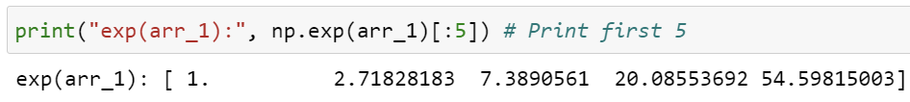
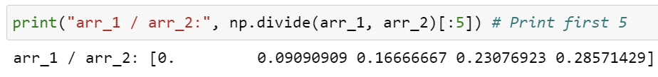
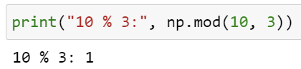
NumPy Arithmetic Operators
Operator
Example
Exponent
Division
Modulo
np.exp()
np.divide()
np.mod()

Slide 51
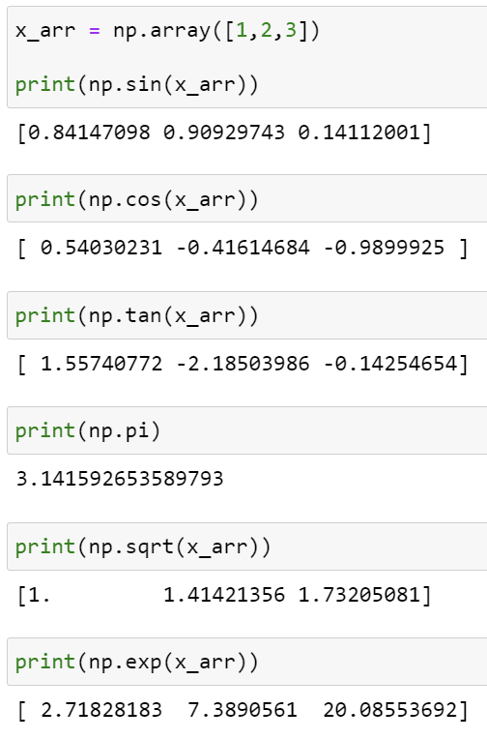
Math Operators
Operator
Example
Sine
Cosine
Tangent
np.sin(x)
np.cos(x)
np.tan(x)
Note: Trigonometric functions require radians as inputs

Slide 52
Math Operators
Operator
Example
Pi
Square Root
np.pi
np.sqrt(x)
More functions: https://numpy.org/doc/stable/reference/routines.math.html

Slide 53




Combining Arrays
Operator
Example
Concatenation
Stack Dimensions
Horizontal Stack
Vertical Stack
np.concatenate()
np.stack()
np.hstack()
np.vstack()
Notes:
MO: I think it would be useful to have a 2D example to explain the difference between the top and bottom two.

Slide 54
Combining Arrays
Operator
1D
2D
np.concatenate()
np.stack()
Existing dimension
Existing dimension
arr1
arr1
arr2
arr2
New dimension
New dimension
arr1
arr1
arr2
arr2

Slide 55
Combining Arrays
Operator
1D
2D
np.hstack()
np.vstack()
Column wise
Column wise
arr1
arr2
arr1
arr2
Row wise
Row wise
arr1
arr1
arr2
arr2

Slide 56




Array Splitting
Operator
Example
Split the array into sub-arrays
(axis defines direction)
Split the array column-wise
Split the array row-wise
np.split()
np.hsplit()
np.vsplit()

Slide 57




Characteristic Values of Arrays
Operator
Example
Minimum Value
Maximum Value
Mean Value
Summed Value
np.min()
np.max()
np.mean()
np.sum()
Note: axis parameter allows you to compute characteristic value alongside specific axis - e.g. np.sum(arr_1, axis =0): summation along row axis.

Slide 58




Indexing Arrays
Operator
Example
Minimum Value Index
Maximum Value Index
Sort Indices (low to high)
Find Indices satisfying a Condition
np.argmin()
np.argmax()
np.argsort()
np.where()

Slide 59
Plotting with Matplotlib

Slide 60

Basic Plotting with Matplotlib
Import Matplotlib
Code
Output

Slide 61

Labeling Your Plots
Code
Output

Slide 62

Multiple Plots
Code
Output

Slide 63

Creating Subplots
Code
Output
Official documentation: https://matplotlib.org/stable/tutorials/introductory/usage.html#sphx-glr-tutorials-introductory-usage-py

Slide 64
LAB 1 SUPPLEMENTARY: BASIC DEBUGGING WITH PYTHON General Tips on Minimizing Errors Debugging with ‘print’ Debugging with PDB Using Google/Stack Overflow

Slide 65
General Tips on Minimizing Errors
Do not panic when you get errors
Outline your code structure ahead of time
Keep your code organized
Test your code often
More tips on avoiding errors by Berkeley online textbook https://pythonnumericalmethods.berkeley.edu/notebooks/chapter10.00-Errors-Practices-Debugging.html

Slide 66
Basic Debugging with ‘print’
Code block 1
print(“done running block 1”)
Runs when code block 1 doesn’t produce an error
Code block 2
print(“done running block 2”)
Runs when code block 2 doesn’t produce an error
Code block 3
.
.
.
print(“done running block 3”)

Slide 67
Basic Debugging with ‘print’
x = …
print(x)
x = …
Check if x value is correct
Code that processes x Produces y
Code that processes x Produces y
y = …
y = …
print(y)
Code that processes y Produces z
Check if y value is correct
Code that processes y Produces z
z = …
z = …
print(z)
Check if z value is correct
Original code
Debugging each step with print()

Slide 68

Python Debugger
What is Python Debugger (PDB)?
Debugging tool built in Python
No installation required
Provides Interactive environment
Widely used for systemic debugging
Notes:
Degrees

Slide 69

PDB Basics
Upon execution of the code, activates Python debugger console at this line
Python debugger console
Notes:
Breakpoint, help

Slide 70
PDB Useful Commands
h: help
w: where
n: next
c: continue
p: print
l: list
q: quit
Notes:
Breakpoint, help

Slide 71

PDB Useful Commands
h: help
w: where
n: next
c: continue
p: print
l: list
q: quit
Provide documentation for the command
Notes:
Breakpoint, help

Slide 72

PDB Useful Commands
h: help
w: where
n: next
c: continue
p: print
l: list
q: quit
Print a stack trace (i.e. the order of code being executed), with the most recent frame at the bottom.
Notes:
Breakpoint, help

Slide 73

PDB Useful Commands
h: help
w: where
n: next
c: continue
p: print
l: list
q: quit
Executes the next line of code
Notes:
Breakpoint, help

Slide 74

PDB Useful Commands
h: help
w: where
n: next
c: continue
p: print
l: list
q: quit
Run the code until the next breakpoint()
Notes:
Breakpoint, help

Slide 75

PDB Useful Commands
h: help
w: where
n: next
c: continue
p: print
l: list
q: quit
Print the value of the desired variable
Notes:
Breakpoint, help

Slide 76

PDB Useful Commands
h: help
w: where
n: next
c: continue
p: print
l: list
q: quit
Similar to where but print the lines of code from the current stack frame
Notes:
Breakpoint, help

Slide 77

PDB Useful Commands
h: help
w: where
n: next
c: continue
p: print
l: list
q: quit
Exit the debugger console
Useful video tutorial of basic usage of Python debugger: https://www.youtube.com/watch?v=aZJnGOwzHtU
Notes:
Breakpoint, help

Slide 78


Using Google/Stack Overflow

